Slide 1

Customer ratings analysis and insights
16th July 2023

Slide 2
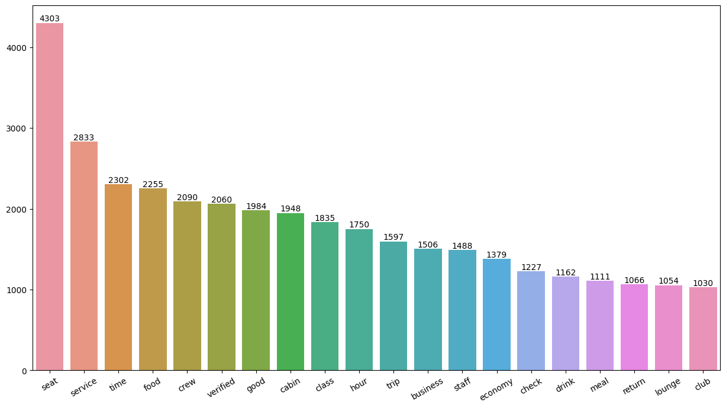
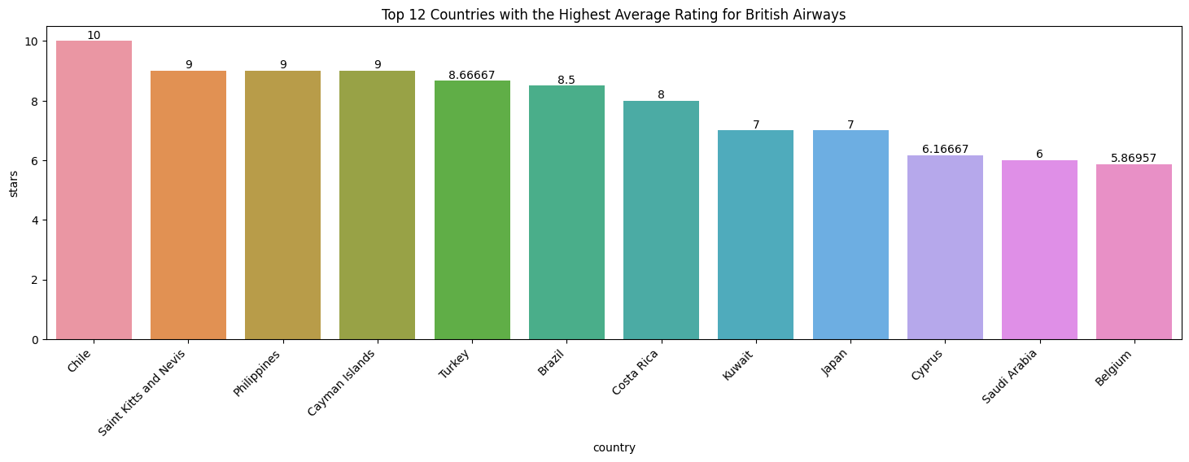
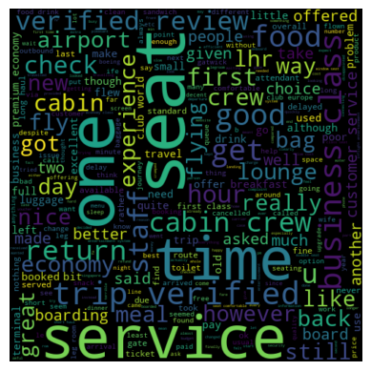
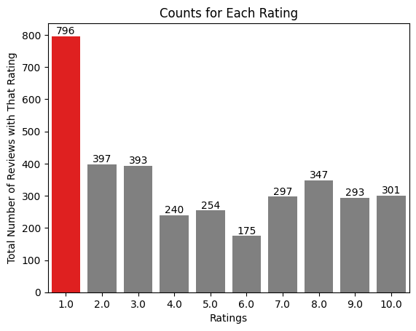
Key Metrics
4.84 /10
Average Overall Rating
69
Unique Countries
3493
Total reviews collected
Ratings | Review
7-10 | Comfortable seats, good inflight entertainment, descent food quality
4-6 | Small entertainment screen, long passport check queue, bad business class experience
1-3 | Congested middle seat, small screen, but liked the seats and the food
Customers appreciated the cabin crew service, staff, and general economy seats. Many also traveled in business class, expecting value for money.
Areas for improvement include enhancing economy class service, seats, and inflight entertainment, addressing delays, and improving customer service for refund requests and processing.
2344
Positive Reviews
20
Neutral Reviews
1129
Negative Reviews
16th July 2023

